Slide 1


The Fine Tuners
21.11.2023
Presented by Erjon Buka

Slide 2
Table of Content
Goals Review
01
02
Pull the tweets
Analyze the tweets
03
04
Get Suggestions
Conceptual Dashboard
05

Slide 3
Goals Review
The model is not a substitute for maintenance scheduling and planning
The model is not a PR metric
The model can help the maintenance team with:
Identifying Common Issues
Trend Analysis
Predictive Maintenance
Resource Allocation
Real Time Monitoring
Notes:
I would like to go back to business understanding

Slide 4
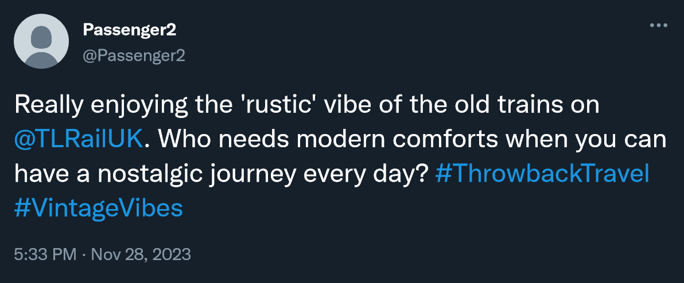
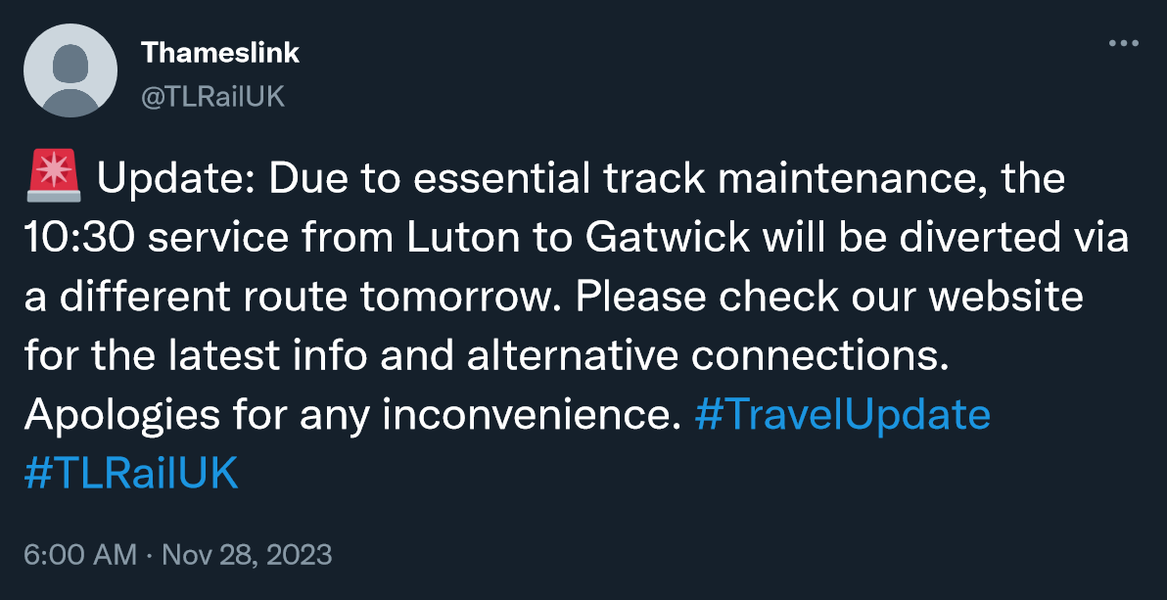
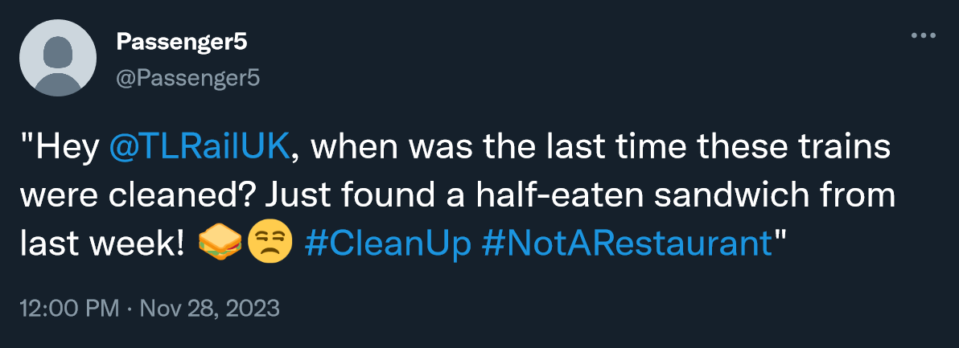
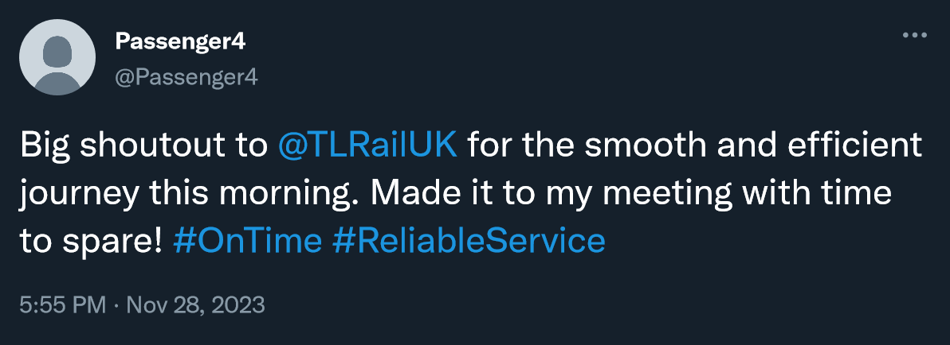
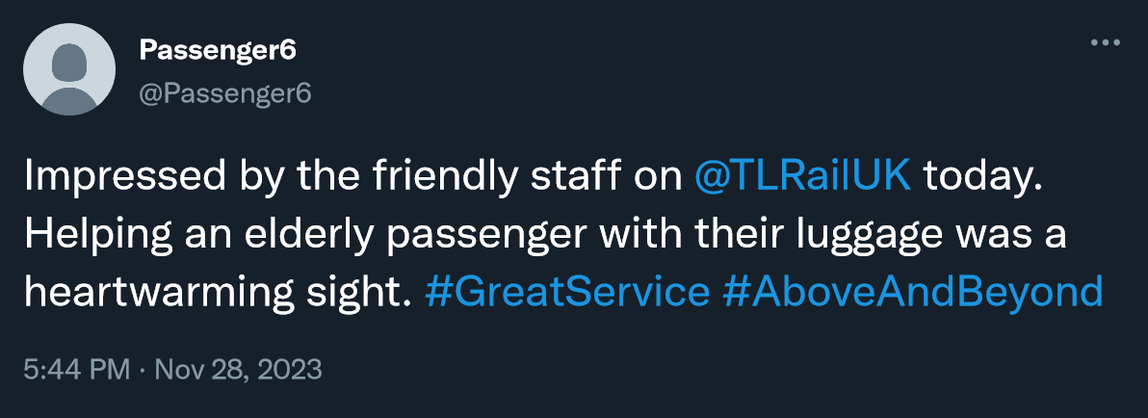
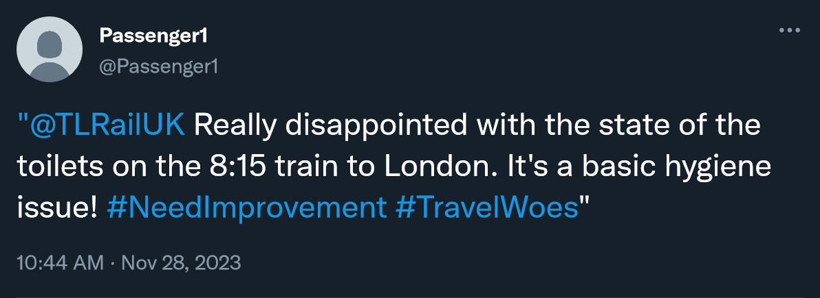
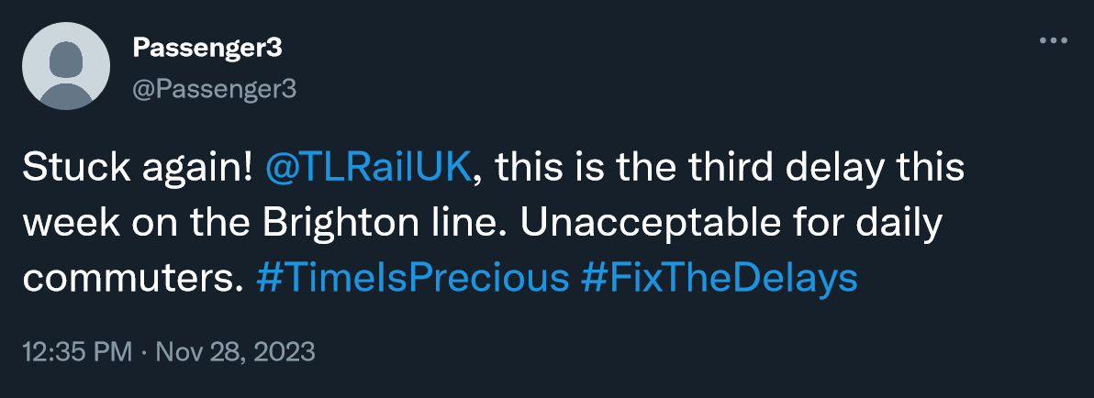
Model – Pull Tweets from API
Connect to API 2.0
Pull the relevant information from API
Author ID*
Text
Date
From last day only
Original posts
* Anonymized. Used only to identify potential troll accounts

Slide 5
Model – Analyse the Tweets
Tweets that originate from @TLRailUK*
The maintenance team is interested in understanding the customer’s issues, tweets from the service provider are not relevant for this purpose
* Filter directly during API pull

Slide 6
Model – Analyse the Tweets
Tweets that are about delays*
Already have the delays from operational data
Focus on areas that can lead to direct action
Delays are caused by outside factors
* Filter using string matching
Notes:
The maintenance team already tracks and analyses delays from operational data.
The team wants to focus on areas that can lead to direct action. Delays are generally caused by factors outside of the maintenance team’s control

Slide 7
Model – Analyse the Tweets
Ironic Tweets*
Negative sentiment through positive words
Misinterpreted by models
LLM - True sentiment capturing
*TweetNLP library, irony detection model
Notes:
Ironic tweets often express negative sentiment through positive words, which can be misinterpreted by standard sentiment analysis algorithms.
Analyzing them separately ensures that their true sentiment is captured and understood.

Slide 8
Model – Analyse the Tweets
Positive / Neutral Sentiment Tweets*
The primary focus of the team is identifying areas needing improvement.
*TweetNLP library, sentiment analysis model
Notes:
The primary focus of the team is identifying areas needing improvement. Focusing on negative sentiment tweets provides more opportunities to do so.

Slide 9
Model – Analyse the Tweets
Negative Sentiment Tweets*
Indicative of problems experienced by customers.
Helps in specific issues that need to be addressed.
*TweetNLP library, sentiment analysis model
Notes:
Negative feedback is directly indicative of problems experienced by customers. Focusing on such tweets helps in pinpointing specific issues that need to be addressed.

Slide 10
Model – Get Suggestions from GPT
Suggestion 1
GPT3.5
Suggestion 2
Suggestion 3

Slide 11
Model - Get Suggestions from GPT
Suggestion 1
GPT3.5
Suggestion 2
Suggestion 3

Slide 12
Model - Get Suggestions from GPT
Plan phased updates of train interiors, prioritizing high-traffic routes, to address both cleanliness and modernization.
Suggestion 1
Initiate immediate, thorough cleaning of trains, focusing on toilets and overall compartment cleanliness. Establish a regular inspection routine to maintain standards.
Suggestion 2

Slide 13
Dashboard

